Slide 1
CROP YIELD PREDICTION
Using Regression in
Tamil Nadu
A simple data-based look at paddy yield trends and future estimates
PRESENTED BY:
S.SIVA YASHODA – 11259A398
P.DIVYA VANI – 11259A362
S.JAYATHRI – 11259A389

Slide 2
Why look at crop yield?
The idea is to use past records to make a sensible estimate for the next season.
• Agriculture depends on rainfall, water availability, soil, and farming practices.
• Yield can rise or fall from one year to another, so planning is not always easy.
• Regression helps us study the general trend in historical yield data.
• The estimate can support planning for storage, transport, and farm resources.
Focus crop
Paddy (rice)
A major food crop in Tamil Nadu, with yield affected by both weather and farm inputs.
2

Slide 3
Aim and objectives
What this small project tries to do
• Aim: estimate Tamil Nadu paddy yield using a simple linear regression model.
• Study the year-wise pattern in yield instead of relying on one year's result.
• Draw a best-fit line to show the overall direction of the data.
• Compare the model's fitted values with the example historical values.
• Discuss where regression is useful and where it can go wrong.
3

Slide 4
Data and variables
For a real submission, replace the demo values with official year-wise data.
Independent variable (X)
Dependent variable (Y)
Year (2015–2024)
Paddy yield (kg/ha)
The year is used as the input to capture the long-term trend.
Yield is the value the model tries to estimate from the year.
Important: these values are illustrative for demonstrating the method, not official measured statistics.
4

Slide 5
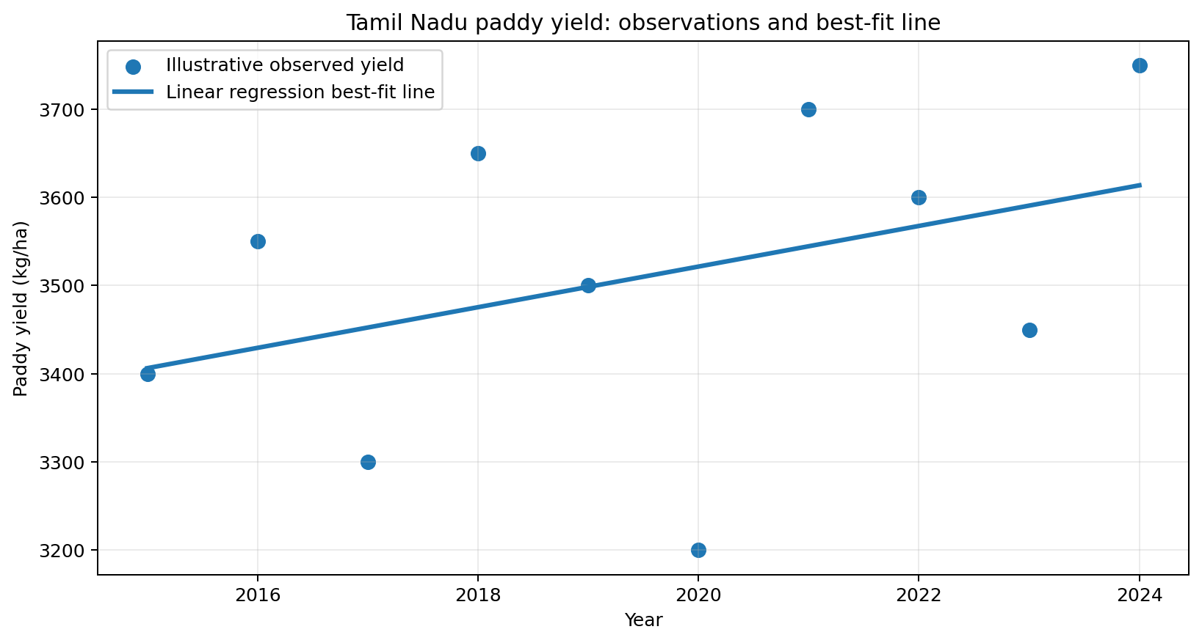
How linear regression works
It fits a straight line that stays as close as possible to the observed points.
Best-fit line equation
ŷ = a + bX
• X = year
• ŷ = predicted yield
• a = intercept; b = slope
Illustrative fit: slope ≈ 23.0 kg/ha per year; R² ≈ 0.16
5

Slide 6
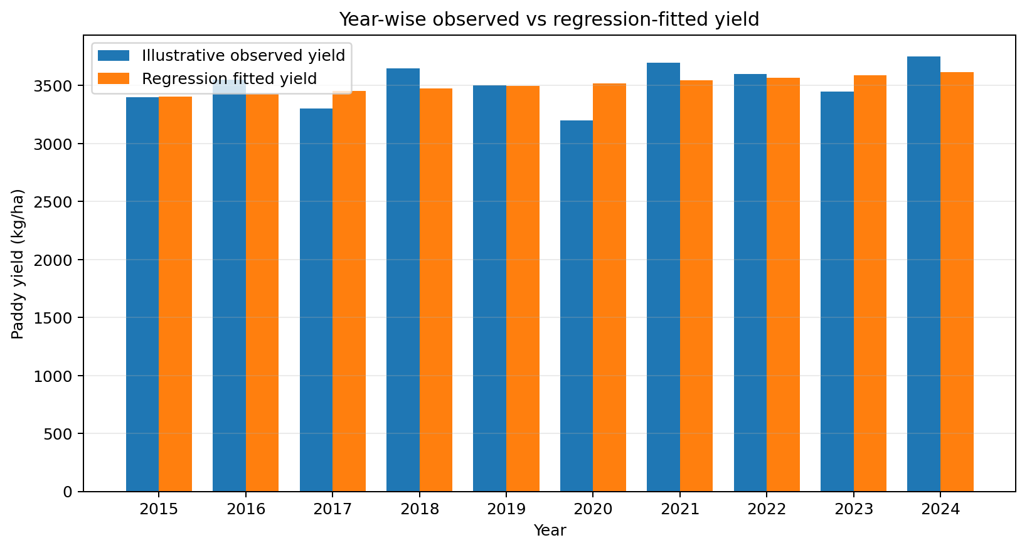
Year-wise comparison
Observed and fitted values are compared to see how closely the line follows the data.
Example values (kg/ha)
Year | Observed | Fitted
2015 | 3400 | 3406
2016 | 3550 | 3429
2017 | 3300 | 3452
2018 | 3650 | 3475
2019 | 3500 | 3498
2020 | 3200 | 3522
2021 | 3700 | 3545
2022 | 3600 | 3568
2023 | 3450 | 3591
2024 | 3750 | 3614
Fitted = line's estimate for that year.
6

Slide 7
The best-fit line
A straight line summarises the overall trend; it does not pass through every point.
Regression equation
ŷ = -89060.3 + (23.0 × Year)
R² = 0.16
This describes the fit on the illustrative data only.
Use real records before drawing conclusions about Tamil Nadu.
7

Slide 8
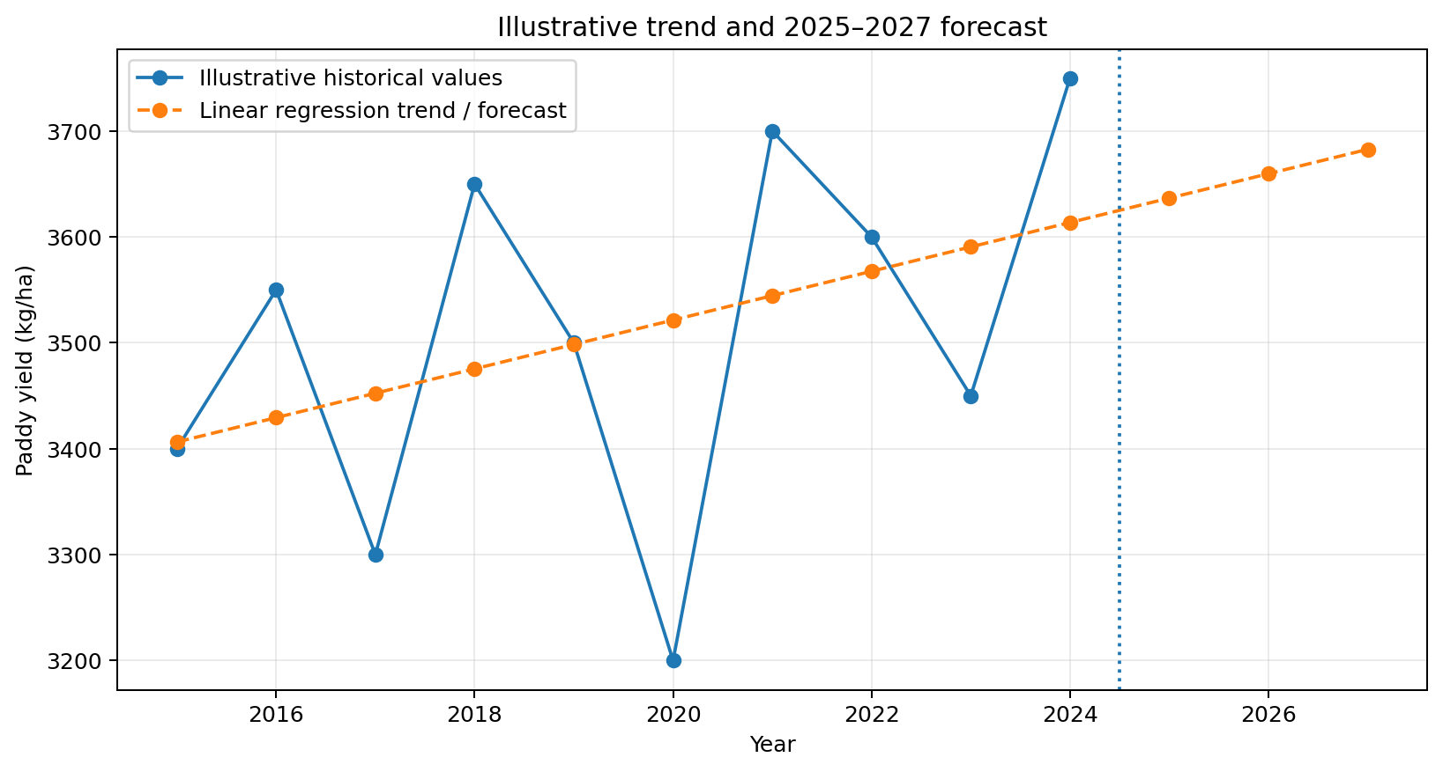
Future yield estimates
A straight-line extension gives a simple baseline, not a guaranteed outcome.
Forecast (illustrative)
2025: 3,637 kg/ha
2026: 3,660 kg/ha
2027: 3,683 kg/ha
These estimates come from the demo line and should not be treated as official forecasts.
8

Slide 9
Advantages and disadvantages
Regression is useful when we understand what it can—and cannot—tell us.
Advantages
Disadvantages
• Easy to understand and explain.
• Shows the direction of a long-term trend.
• Quick to calculate with basic tools.
• Can support early planning and comparisons.
• Year alone cannot explain weather or farming changes.
• A straight line may miss sudden rises and falls.
• Poor or short data can give misleading estimates.
• Past trends may not continue into future years.
9

Slide 10
Conclusion
What we learn from the exercise
• Linear regression gives a clear starting point for studying crop-yield trends.
• The best-fit line summarises the direction of the example data and produces year-wise estimates.
• For a dependable Tamil Nadu forecast, official yield records and weather/farm variables are needed.
• The model should be treated as a planning aid, not a promise of the next harvest.
11

